Slide 1
Veterinary Management System®
.NET · C# · WPF · Cloud database (azure)
Team: lorena gamarra & nedis barreto

Slide 2
Background
•A program for management of a veterinary clinic.
•To make easier the administration of clients, employees, consultation (animal care), services and products.
•Providing the following basic features: animals, owners and employees registration, services and products maintenance also management of the consults.

Slide 3
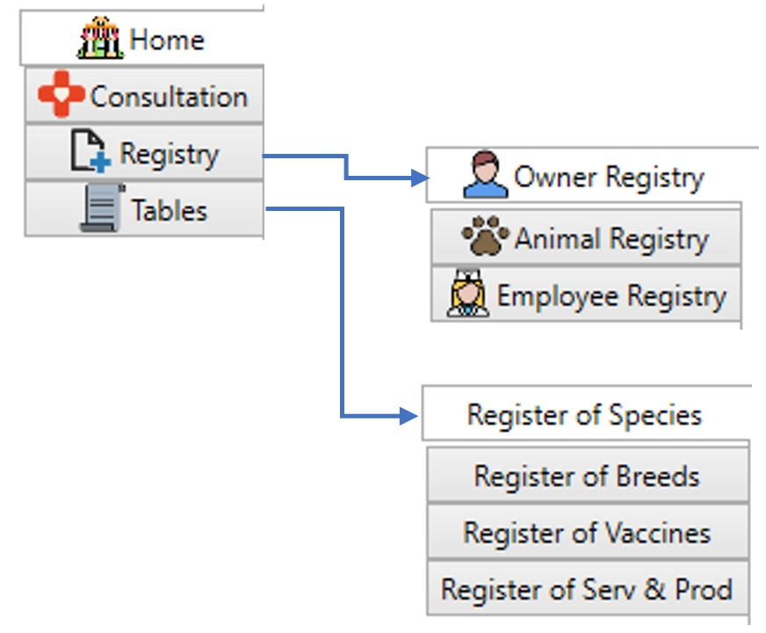
Overview
Intuitive menu: easy access to system options
Basic functions necessary for the daily routine of a veterinary clinic

Slide 4
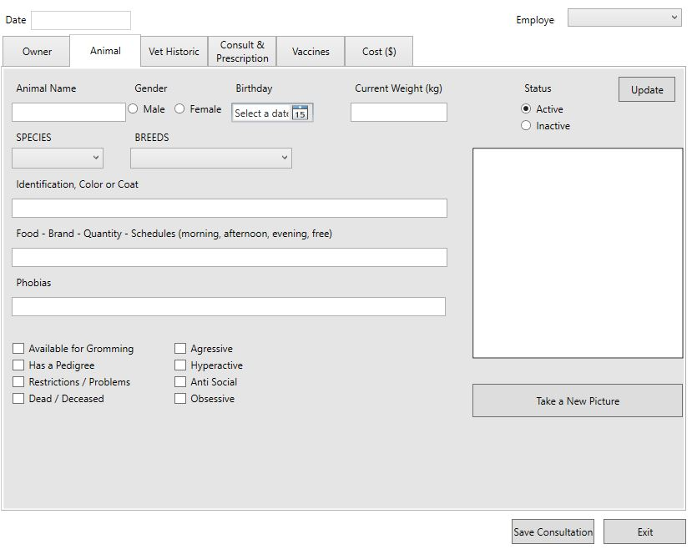
Overview
Offering the option of taking a photo for visual identification
Online data storage (cloud)

Slide 5
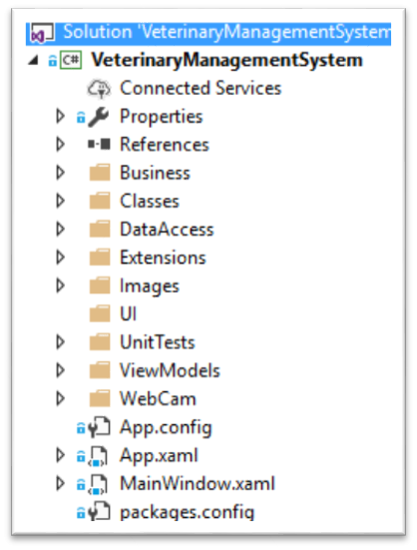

Challenges and solutions
Project structure
Work only with WPF
Database concepts
Photo capture
  Save to DB
  Retrieve from DB
  Populate ComboBox

Slide 6

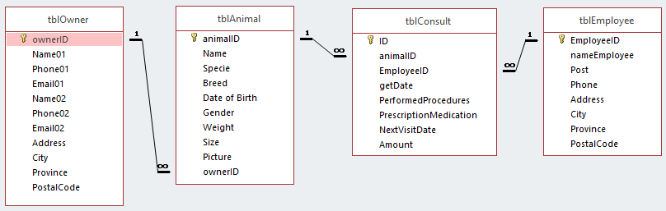
Challenges and solutions
Project structure
Work only with WPF
Database concepts
Photo capture
  Save to DB
  Retrieve from DB
  Populate ComboBox

Slide 7
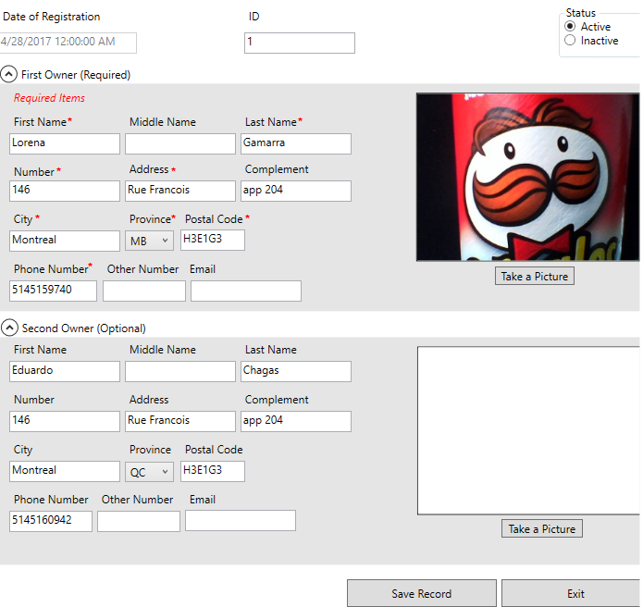
Challenges and solutions
Project structure
Work only with WPF
Database concepts
Photo capture
  Save to DB
  Retrieve from DB
  Populate ComboBox

Slide 8
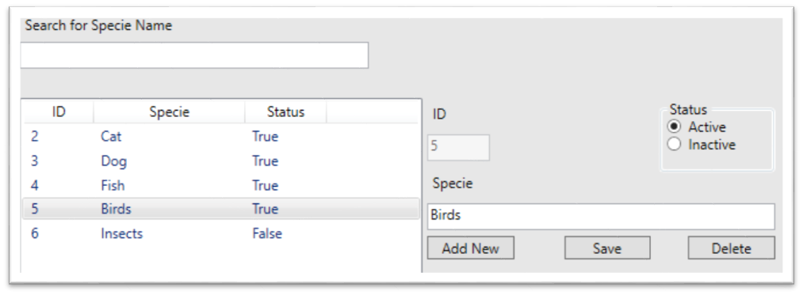
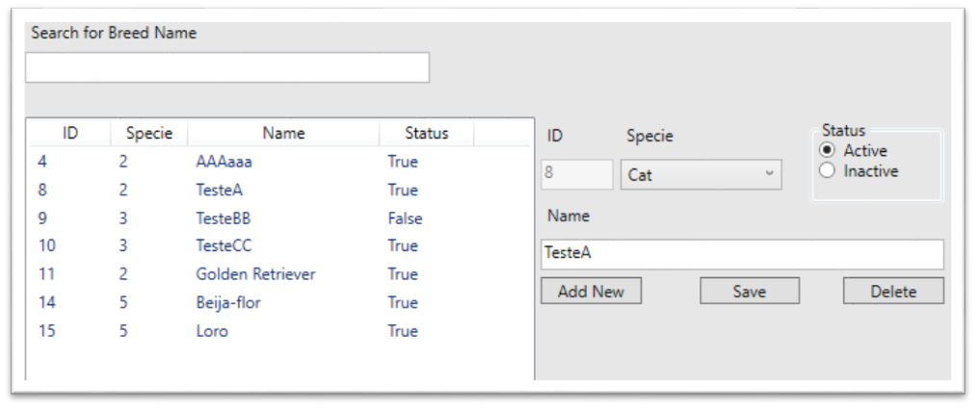
Challenges and solutions
Project structure
Work only with WPF
Database concepts
Photo capture
  Save to DB
  Retrieve from DB
  Populate ComboBox

Slide 9
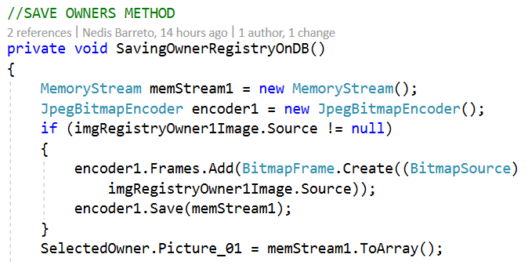
What we learned!
Convert image to Byte
  Populate ComboBox with data from other table

Slide 10
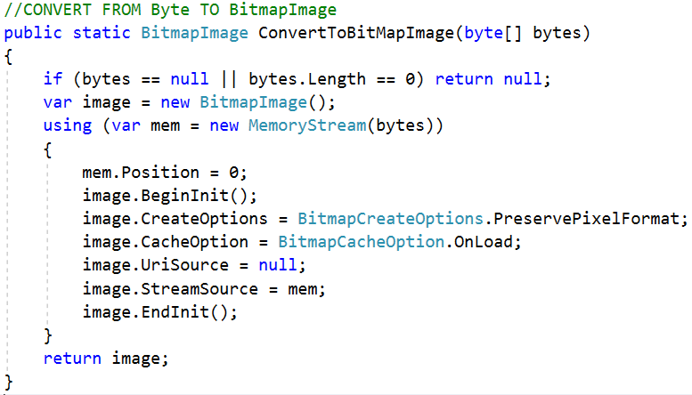
What we learned!
Convert image to Byte
  Populate ComboBox with data from other table

Slide 11
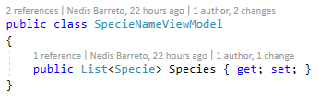
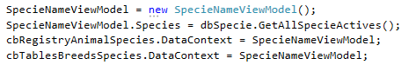
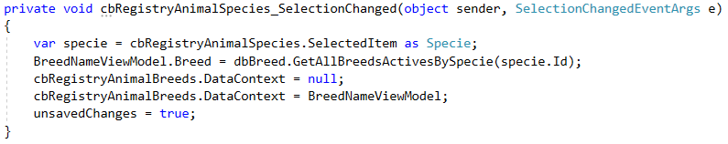
What we learned!
class SpecieNameViewModel
class MainWindow
public MainWindow()
Convert image to Byte
  Populate ComboBox with data from other table
lvTableRegisterBreeds_OnSelectionChanged
btnTablesBreedsSave_Click

Slide 12
Future work
•Finalize Consultation Tab
•Print and send PDF by email
•Change:
  True or False to Active or Inactive Status
  ID to name (SpecieID to SpecieName)

Slide 13
Summary
•Registry
  Owner
  Animal
  Employee
•Secondary Tables
  Specie
  Breed
  Vaccine
  Services and Products

